Slide 1

The Church in Corinth
Rev. Bruce Gowe, OSL
Kings College

Slide 2
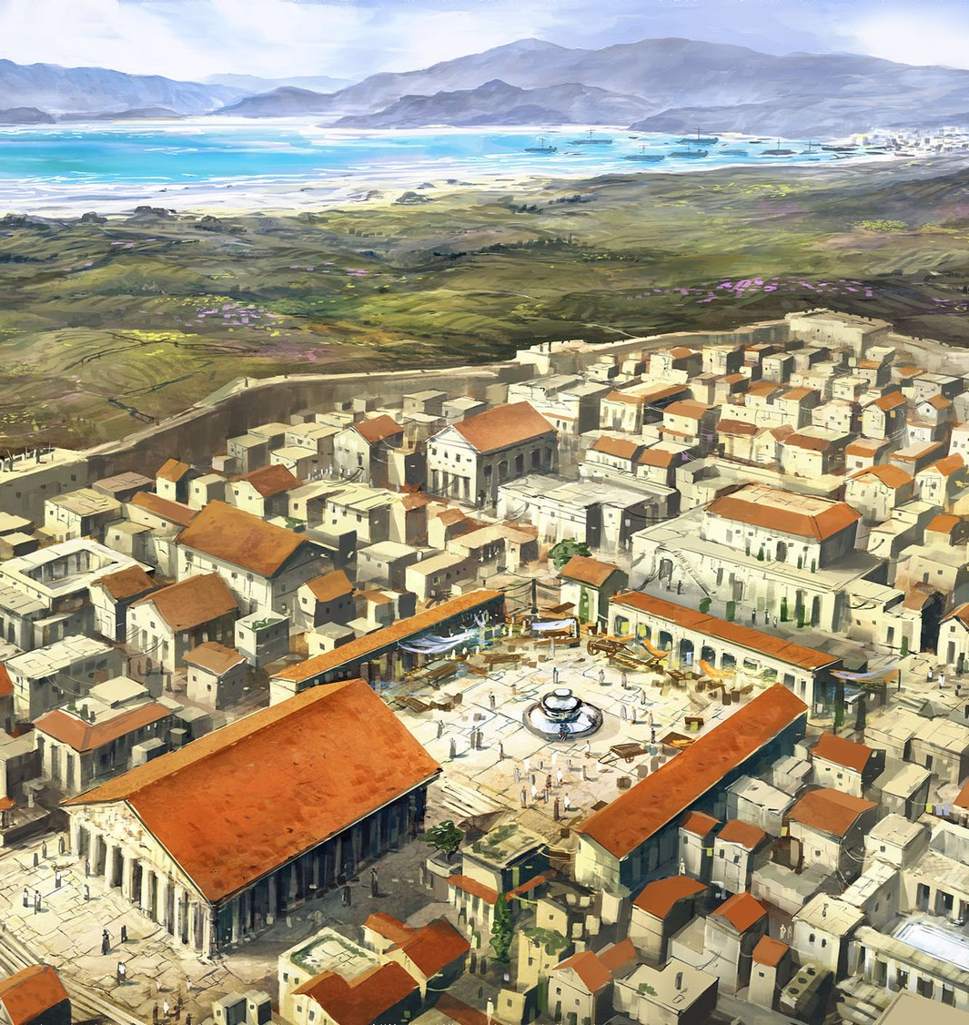
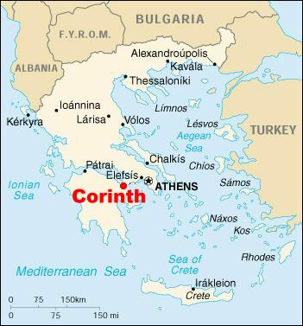
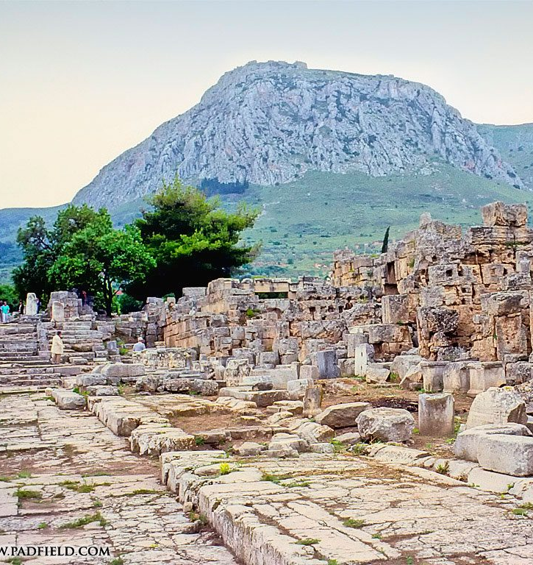
Corinth

Slide 3
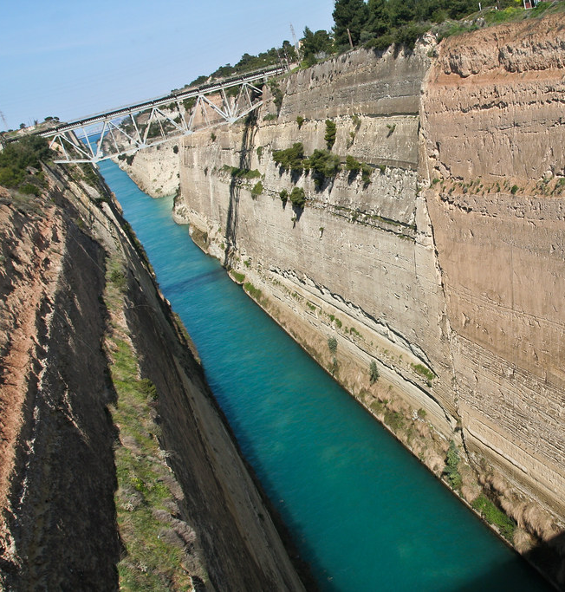
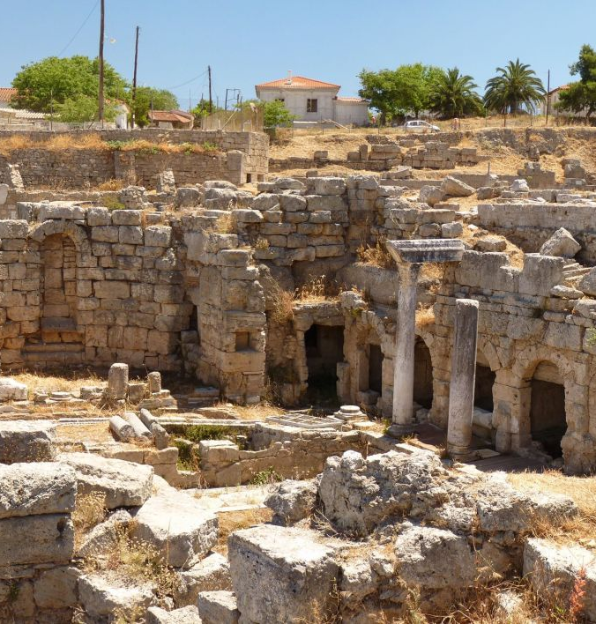
This Photo by Unknown Author is licensed under CC BY
This Photo by Unknown Author is licensed under CC BY-SA-NC

Slide 4
Corinth: The City
Capital of the Roman province Achaia
Two ports with a land bridge between
Isthmian games (rivaled Olympic games)
Diverse, wealthy, upwardly mobile people
Lavish lifestyles (an ancient Las Vegas)
Paul stays with Priscilla and Aquila (50–53 CE)
Notes:
When: Scholars suggest that this letter is written around mid-to late 50’s , during Paul’s 2nd missionary Journey
Where: here in Corinth, Corinth is the Capital of Achaia, located 50 miles from Athens and possible written while he was in Ephesus.
What is Corinth like: Corinth as Powell mentions is like Las Vegas of the Roman world. Known for gambling, sex, Olympic like games, diverse, and where you can possibly start to rise in social class at least wealth
Corinth was a city built by Free citizen slaves , settled in 44 CE
Most were poor but not all
It was rich in trade because of its location and its two –seaports . In fact Rome wanted to have a Canal built to transport material easier, but more of a road then Canal the canal would not be built until 1893

Slide 5
Exchange of Communication
Paul and Corinthians exchanged multiple letters
Only two from Paul still exist
  First “lost” letter Paul wrote; 1 Cor. 5:9
    Corinthians write back with questions (7:1; 16:15–18)
    Chloe sends her servants with a report (1:11)
  1 Corinthians (54 CE)
  Third letter Paul wrote
  2 Corinthians (55-58 CE)
Notes:
Chloe’s report and the churches response

Slide 6

The Purpose of this Letter
Notes:
Paul in this letter is to the Corinth church as a pastoral letter. One who cares for the spiritual, emotional and physical well being of his charge even if its like going through hell.
Corinth was not known for its Greek philosophers and scholar elites like Athens. In fact it was slang when you heard “to act like a Corinthian”. Known for living free and sexually Promiscuity. A big issue that Paul would bring up.

Slide 7
Outline
Salutation and thanksgiving (1:1–9)
Divisions: believers follow different leaders (1:10–4:21)
Boasting in immorality (5:1–6:20)
Specific questions (chaps. 7–14)
  Act with humility (put other first)
  Act with love (for Christ and one another)
Christ crucified (15:1–58)
The collection for Jerusalem poor and closing (16:1–24)

Slide 8
Major Theological Themes
Church Unity
Images: God’s Temple, The Boddy
Wisdom and Power
Christ Crucified
Resurrection of the Body
Christian Freedom

Slide 9
Major Practical Matters
The Lord’s Supper
Excommunication
Idol Food
Love
Spiritual Gifts
Notes:
Paul spends most of his time focusing on answering the problems of the church than their theological understanding. For this letter was a practical letter, a pastoral letter concern with there conduct. Remembering that an individual's conduct is a witness to the Christian conduct.
He will focus on the theological issues in a somewhat systematic way in the letter to Rome. Of which, he does write from Corinth

Slide 10
Paul Addresses Practical Problems
PAUL’S SOLUTION
CORINTHIAN PROBLEM
Unity in Christ by Spirit
God’s wisdom and power in human weakness and foolishness
Christ Crucified: salvation YET to be fully realized
Bodily resurrection—the body is home to Holy Spirit
We are SLAVES of Christ—all is lawful, but then ask: “is this good for me and for Christ’s body?”
Community factions
Obsession with worldly wisdom and power
Fully actualized salvation NOW
Body is irrelevant—only spiritual purity matters
We are FREE! Therefore “all things are lawful”

Slide 11
Paul Addresses Practical Problems
PAUL’S SOLUTION
CORINTHIAN PROBLEM
Social divisions in the Lord’s Supper by class and status
Boasting about sexual freedoms
Only the spirit matters
  Deny the body—it’s bad! ex: abstinence in marriage
  Indulge the body—it doesn’t matter!
  (prostitution and adultery)
Wait for one another;
do not humiliate the poor
Do not boast! Rather, excommunicate the offender (5:13)
The body matters too:
it glorifies God
  Care for personal body
  Care for Christ’s body (respect the Eucharist)
  Care for corporate “body”

Slide 12
Paul Addresses Practical Problems
PAUL’S SOLUTION
CORINTHIAN PROBLEM
Food sacrificed to idols
  DON’T EAT IT!
  Idols have no power—you can eat it
Spiritual Gifts
  Some boast about their “better” gifts
  Divisions: some gifts are better than others
Humility
  Idols have no power, BUT
  Better not to eat if it harms a brother or sister
Love
  No boasting
  All gifts come from one God
  Love unites; boasting divides

Slide 13
Recap Theological Themes
Unity in Christ
Humility toward others in Christ
Love
Body of Christ

